Slide 1
Telecom Industry Customer Churn Prediction
Team Number: 6
Submitted for DATS 6101

Slide 2

AGENDA

Slide 3
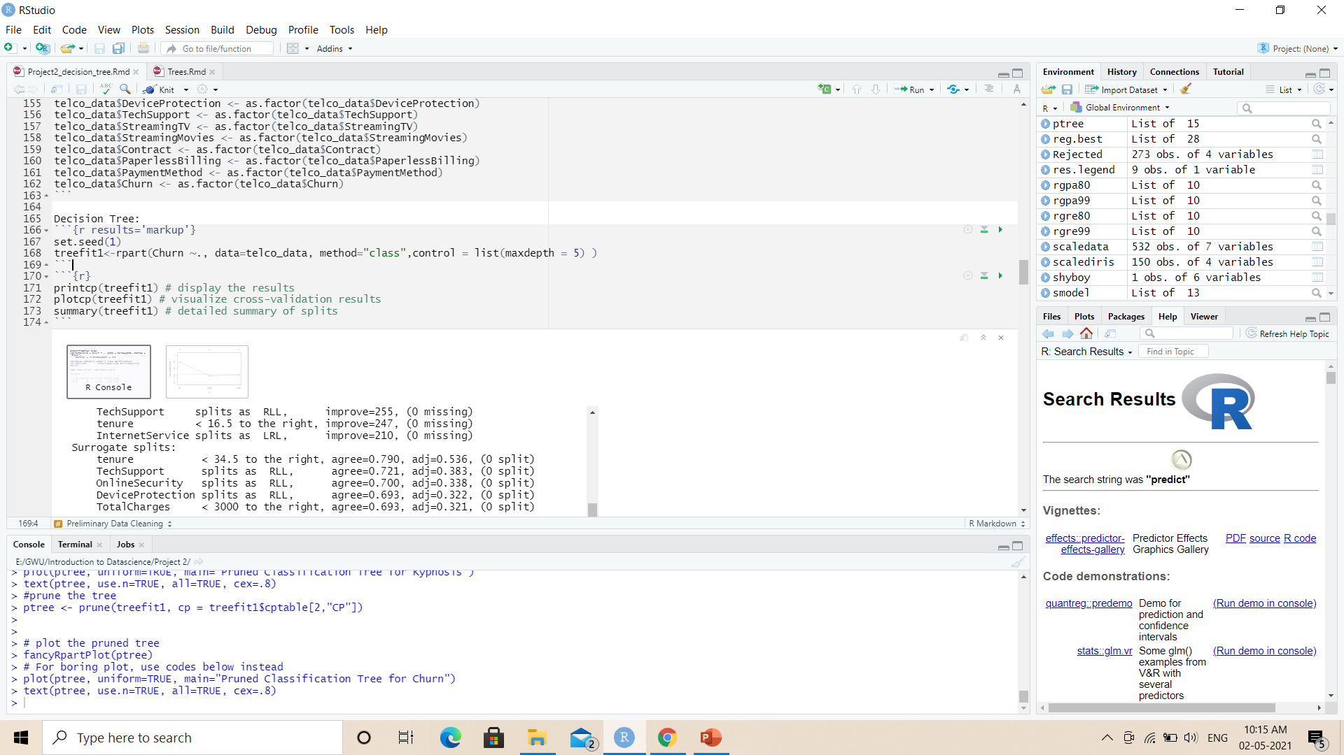
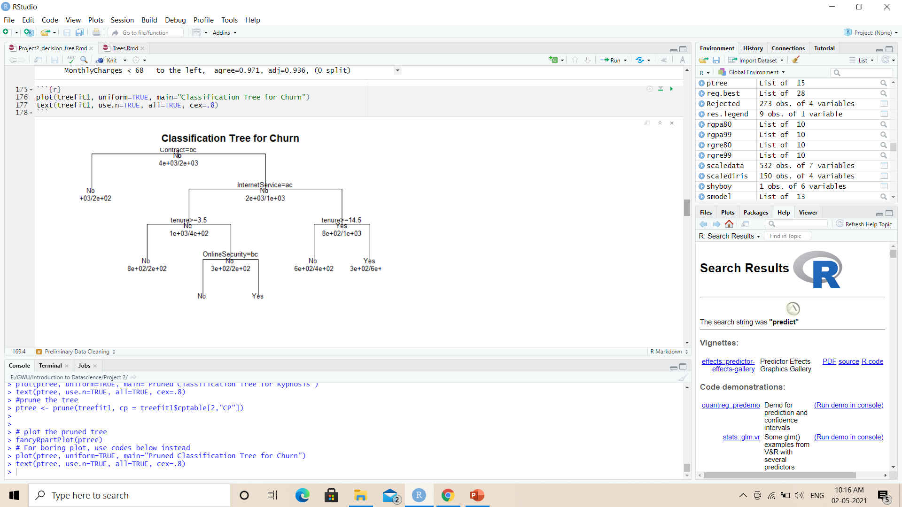
Decision Tree model

Slide 4
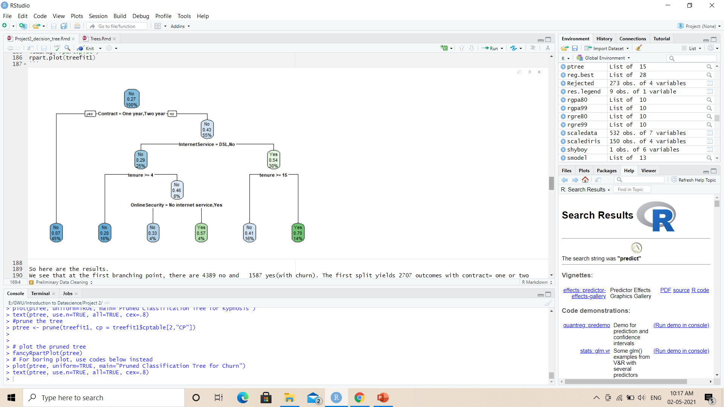
Decision Tree model
The first branching point, there are 4389 no and 1587 yes (churn)
The first split yields 2707 outcomes with contract= one or two years and 3269 outcomes with contract= month to month

Slide 5
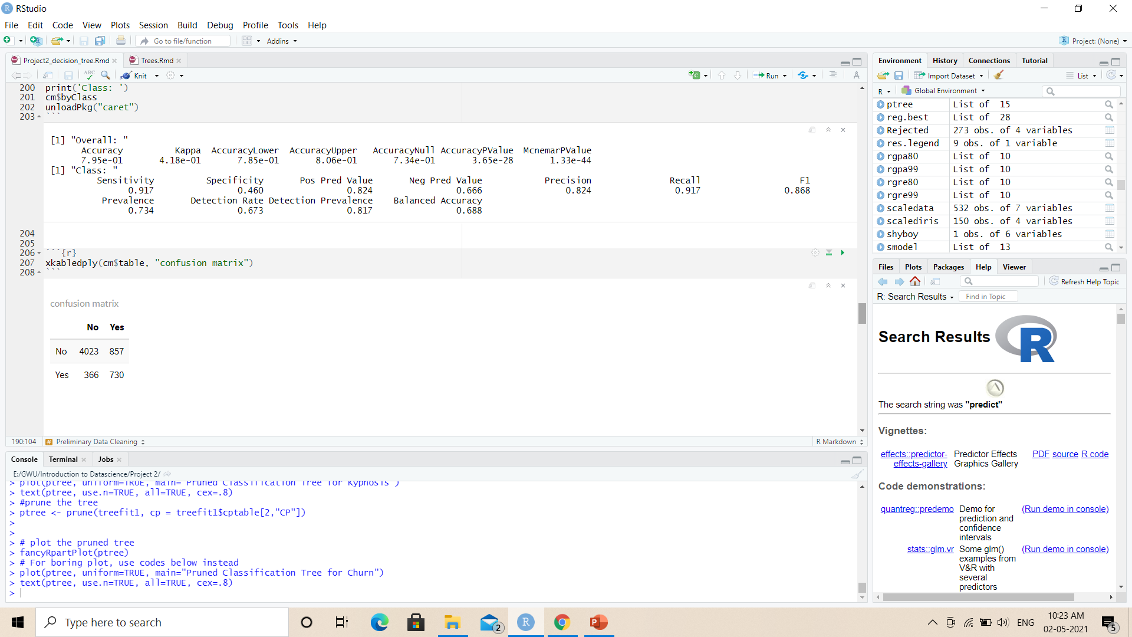

Decision Tree model
The overall accuracy of model is 79.5%

Slide 6
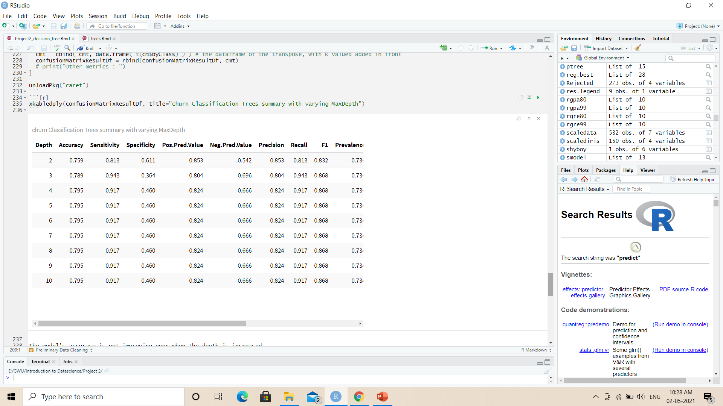
Decision Tree model
Let us try different maxdepths to check whether there is an improvement in model
The model's accuracy is not improving even when the depth is increased.

Slide 7
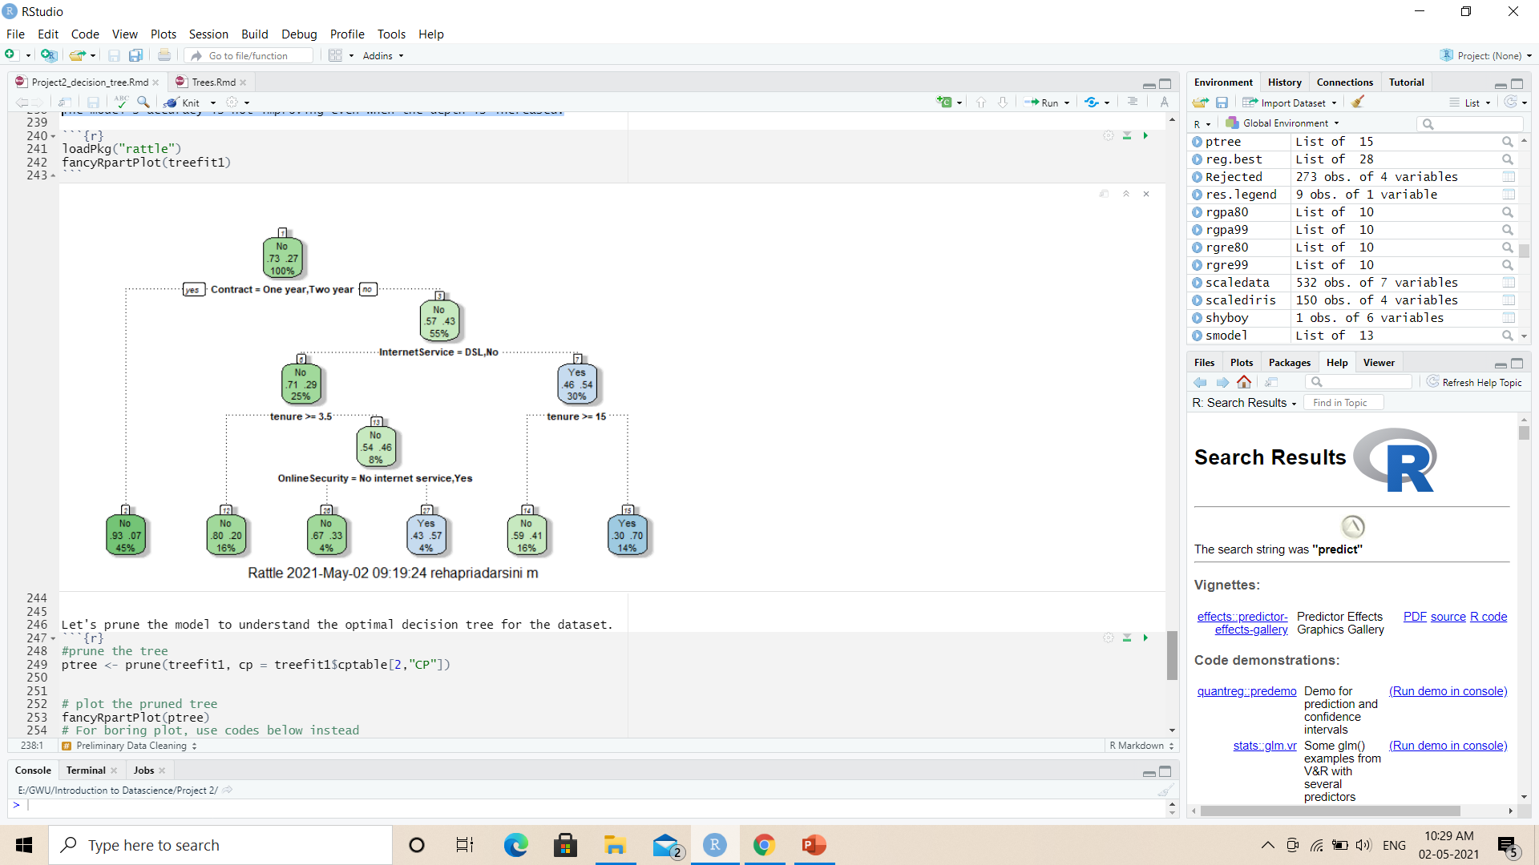
Final Decision Tree model

Slide 8
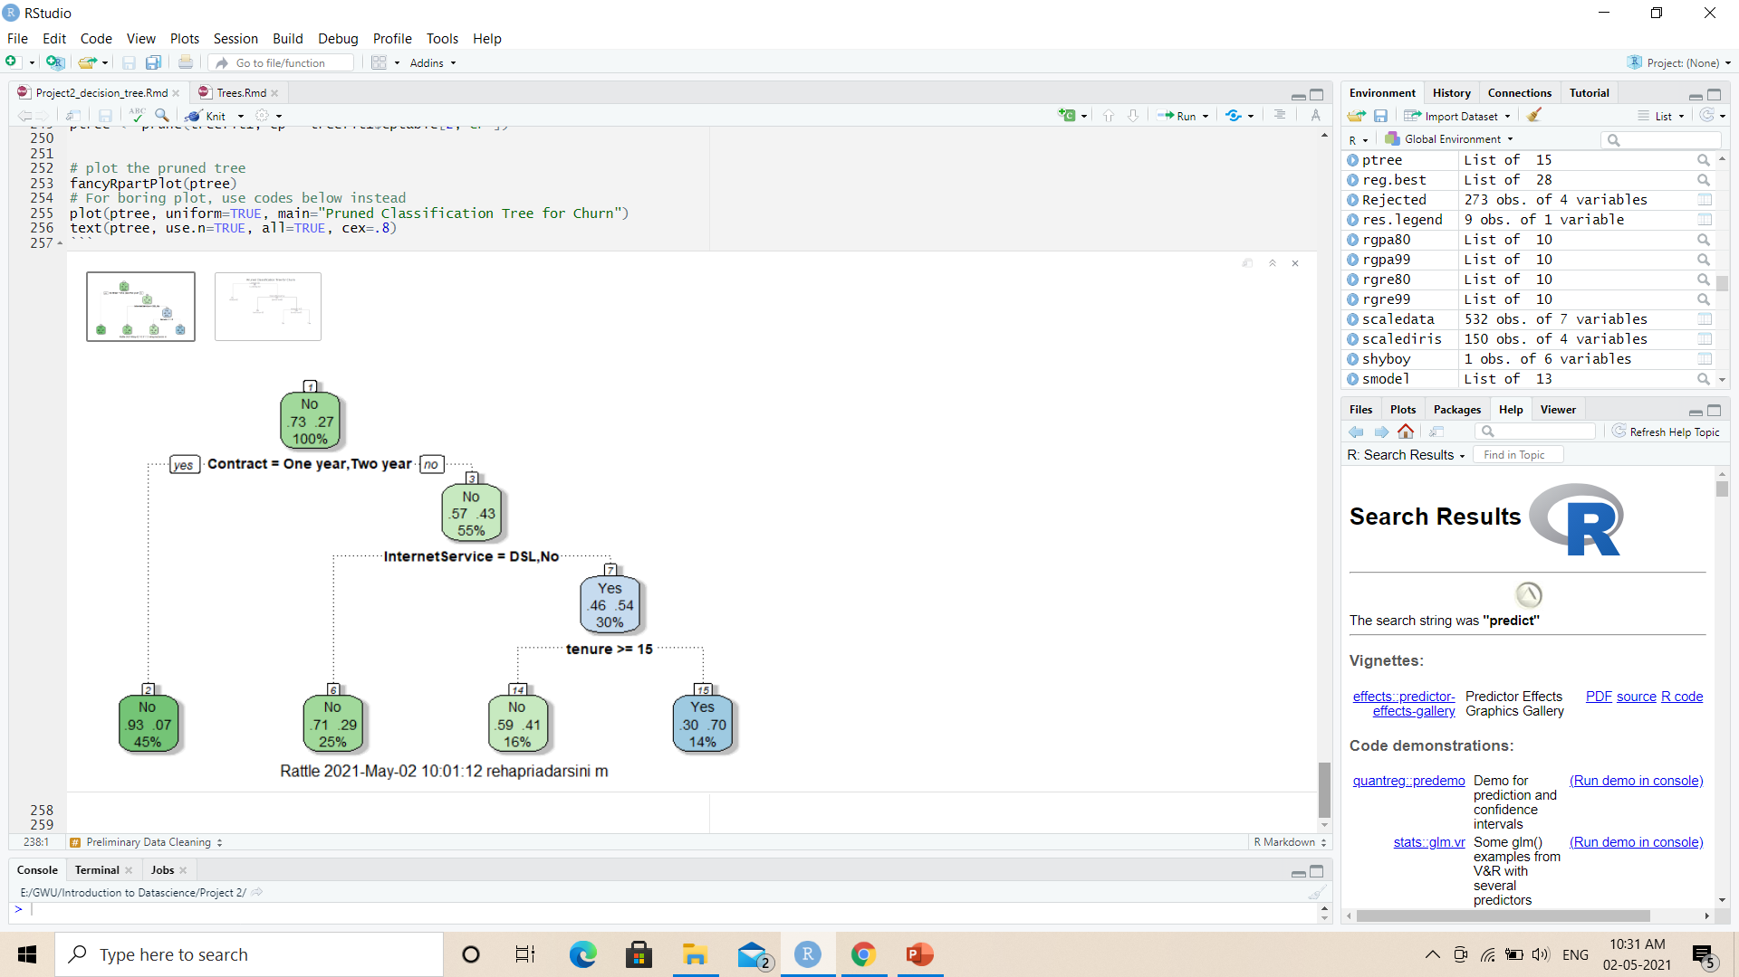
Pruned Tree

Slide 9
GitHub
GitHub link:
https://github.com/adingankar/DATASCIENCE_6101/tree/main/Project%202

Slide 10
Any Questions?

